Slide 1
HO VAN HUE PRIMARY SCHOOL
GRADE 2
Lesson 6

Slide 2
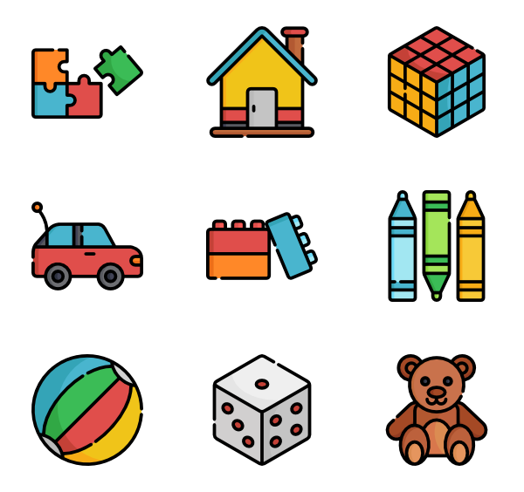
Topic:
Toys

Slide 4
LISTEN AND POINT

Slide 5
Ball

Slide 6
Bus

Slide 7
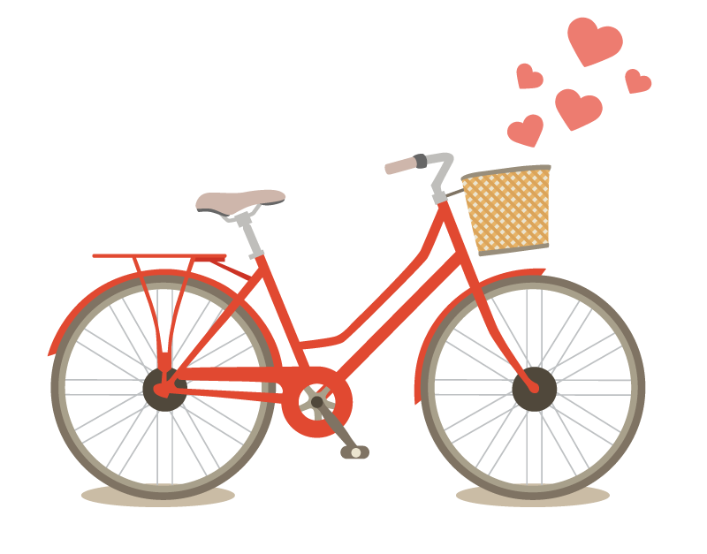
Bike

Slide 8
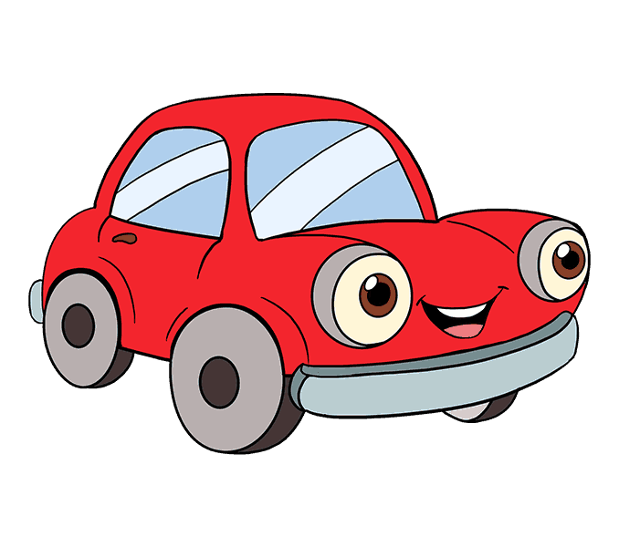
Car

Slide 9
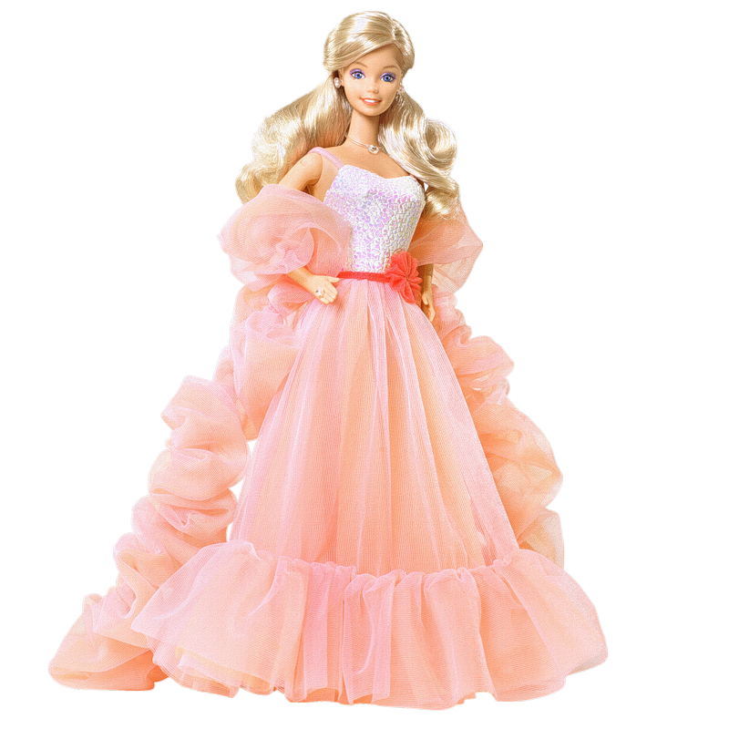
Doll

Slide 10
Kite

Slide 11
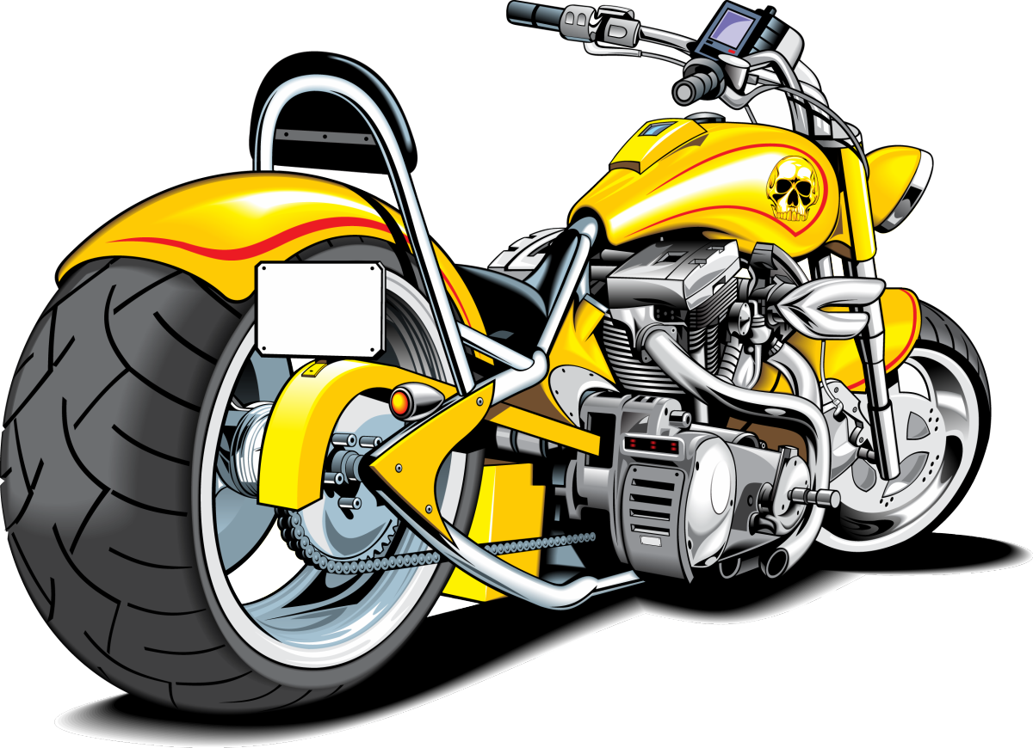
Motorbike

Slide 12
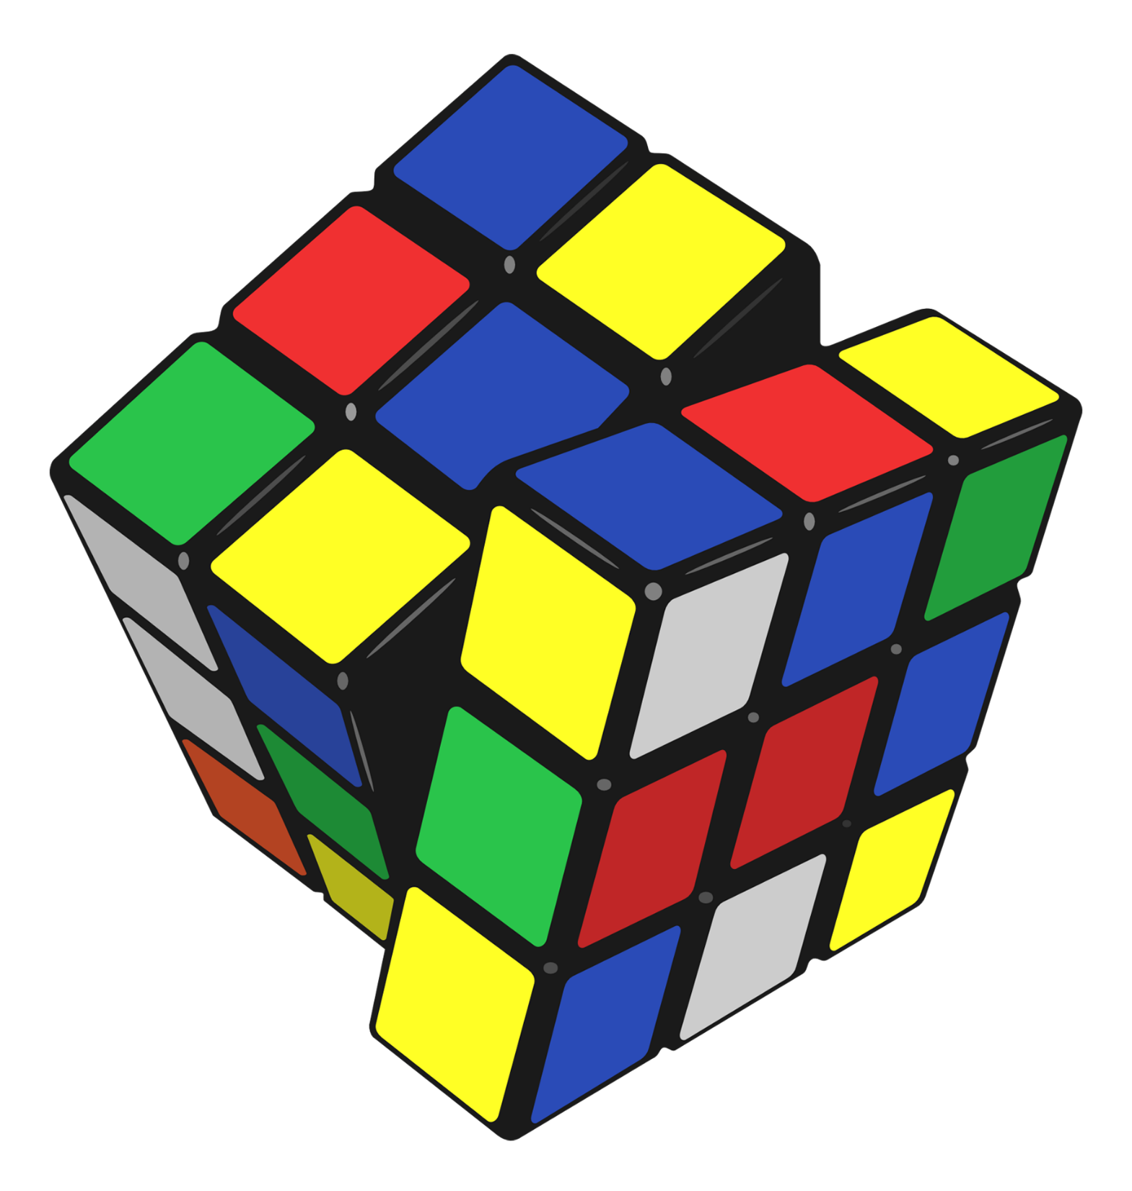
Puzzle

Slide 13
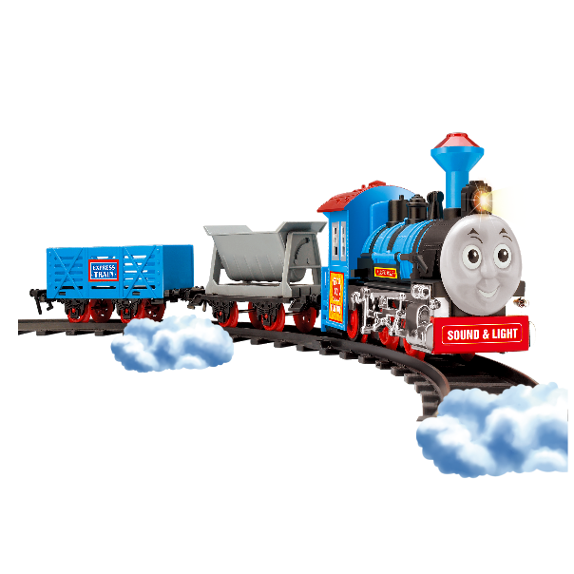
Train

Slide 14
Ship

Slide 15
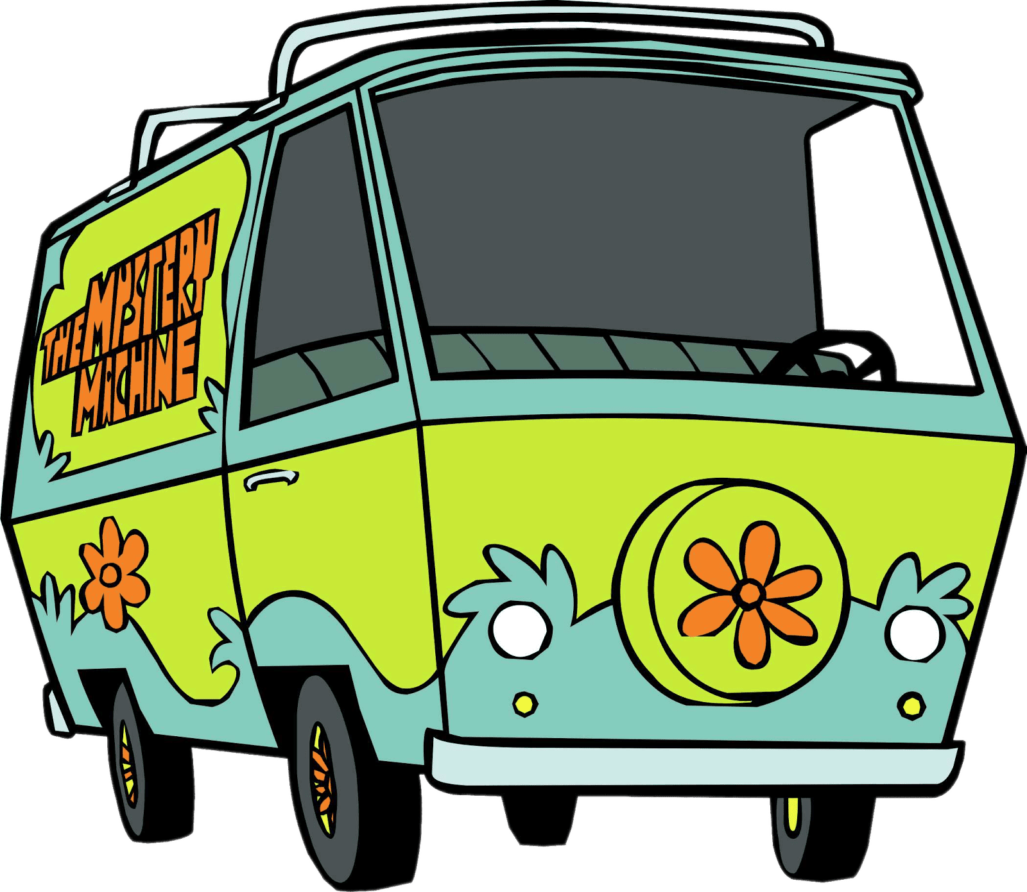
Van

Slide 16
Lorry/
Truck

Slide 17
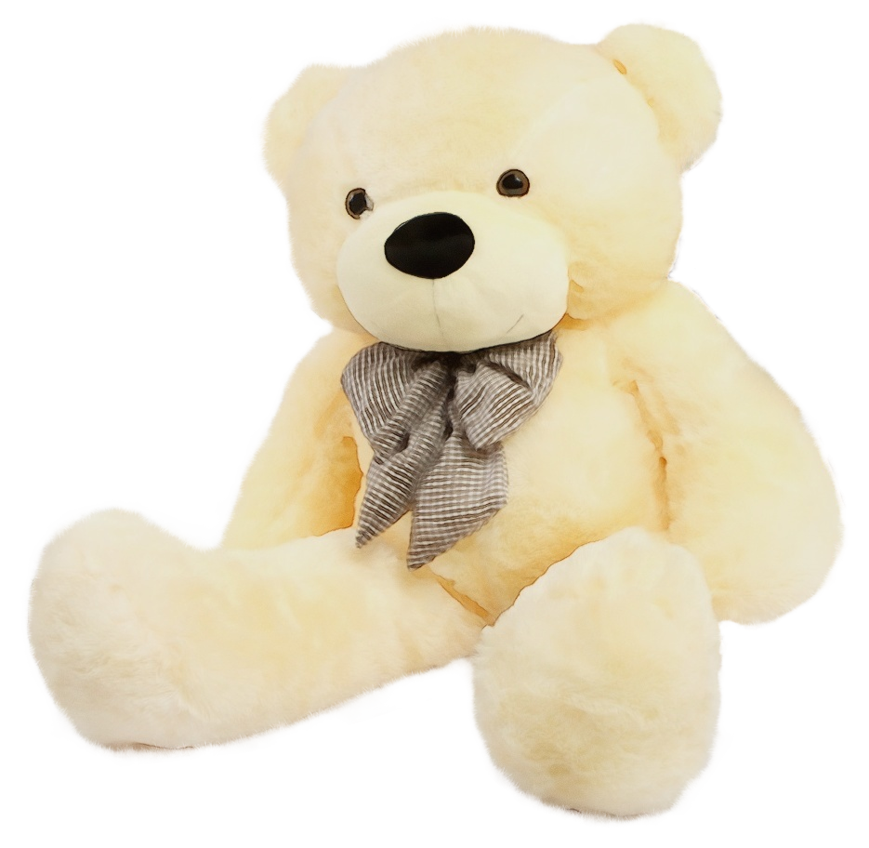
Teddy Bear

Slide 18
Robot

Slide 19
GROUPWORK

Slide 20
Student 1: What toy do you have?
Student 2: I have a…

Slide 21
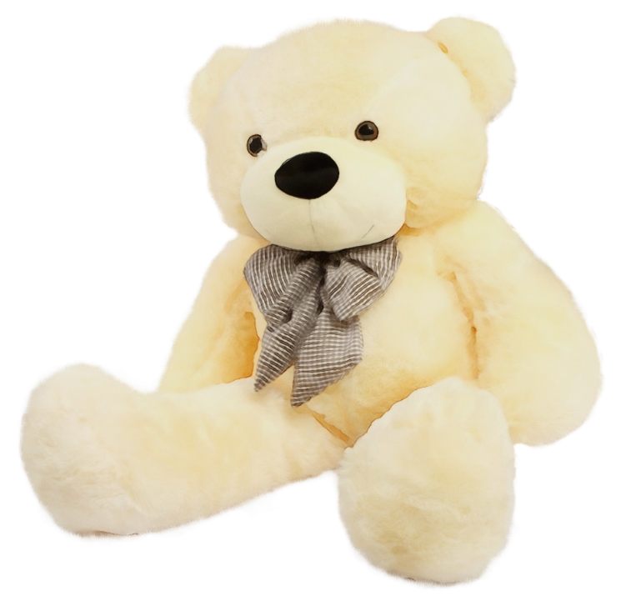
Student 1: What toy do you have?
Student 2: I have a…

Slide 22
Student 1: What toy do you have?
Student 2: I have a…

Slide 23
Student 1: What toy do you have?
Student 2: I have a…

Slide 24
Student 1: What toy do you have?
Student 2: I have a…

Slide 25
Student 1: What toy do you have?
Student 2: I have a…

Slide 26
Student 1: What toy do you have?
Student 2: I have a…

Slide 27
GAME TIME

Slide 28
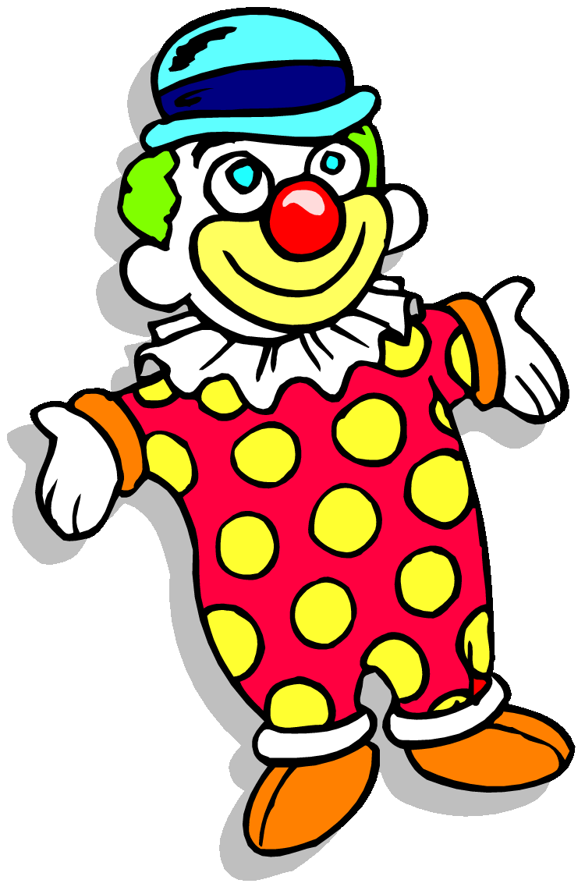
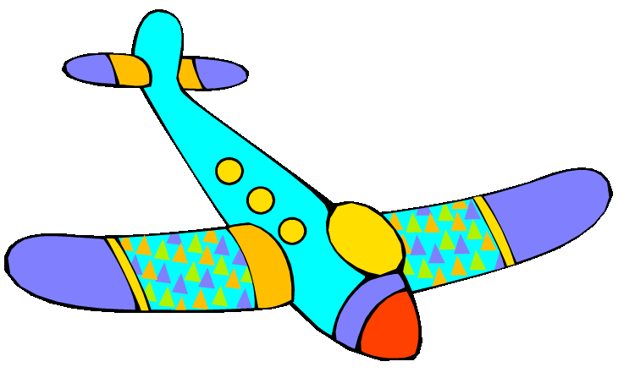
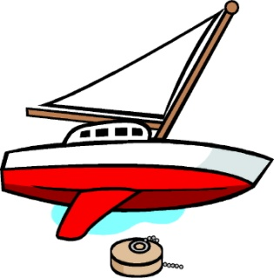
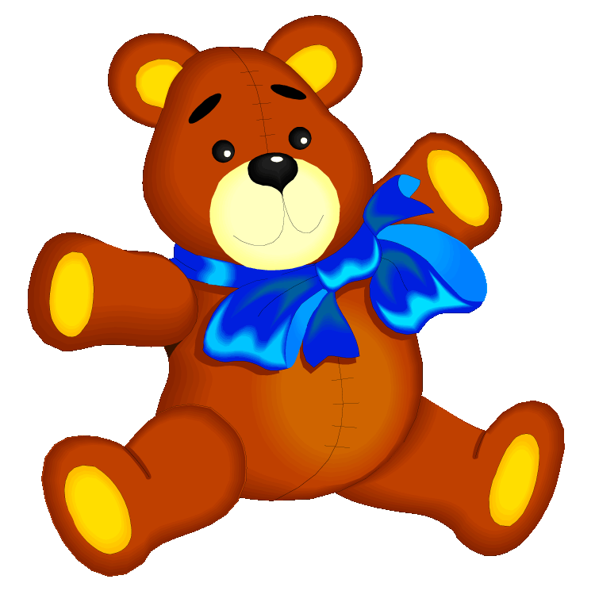
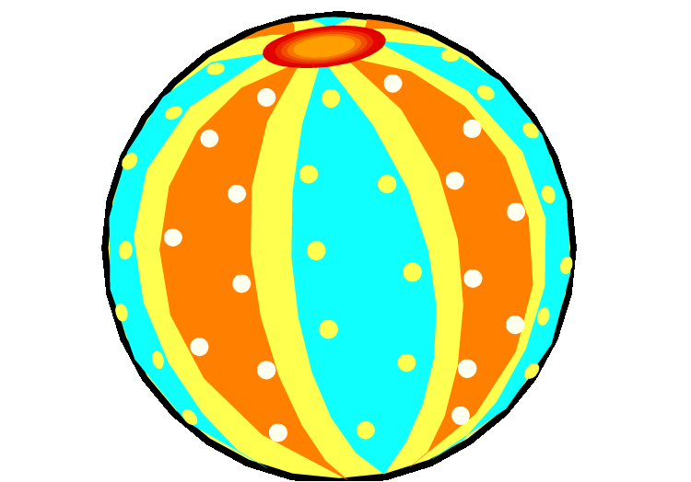
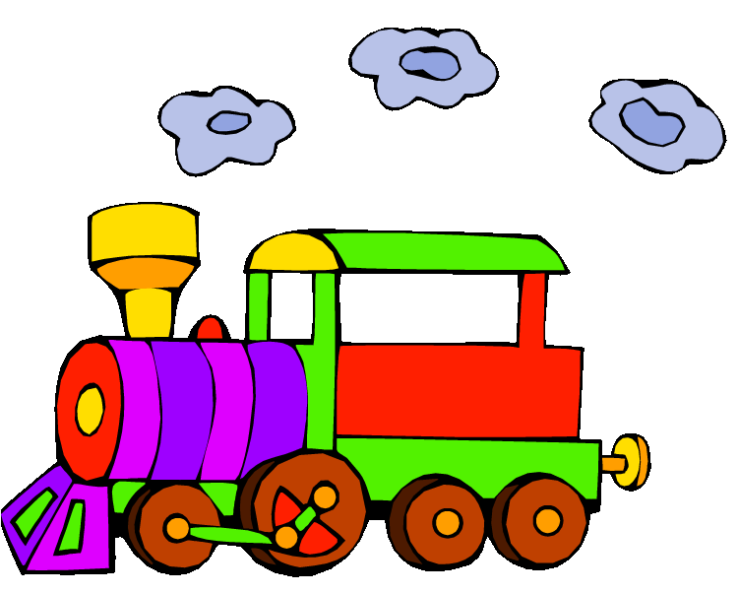
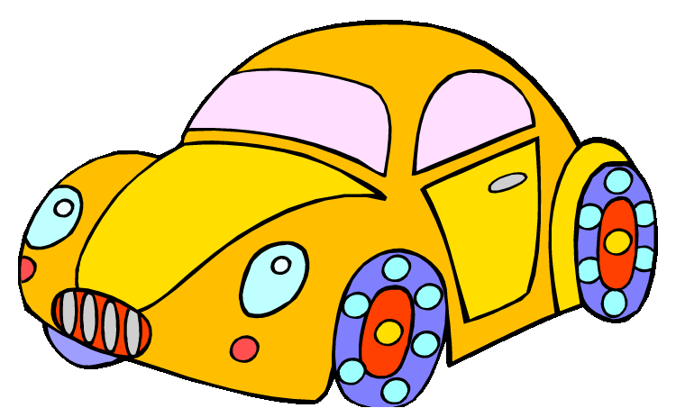
My toys
Let’s play a game!
PLAY

Slide 29
It’s a kite.
1
2
3
Very good!
Next

Slide 30
It’s a robot.
1
2
3
Very good!
Next

Slide 31
It’s a doll.
1
2
3
Very good!
Next

Slide 32
It’s a
teddy bear.
1
2
3
Very good!
Next

Slide 33
It’s a ball.
1
2
3
Very good!
Next

Slide 34
It’s a clown.
1
2
3
Very good!
Next

Slide 35
It’s a car.
1
2
3
Very good!
Next

Slide 36
They are blocks.
1
2
3
Very good!
Next

Slide 37
It’s a train.
1
2
3
Very good!
Next

Slide 38
It’s a drum.
1
2
3
Very good!
Next

Slide 39
It’s a boat.
1
2
3
Very good!
Next

Slide 41
GOODBYE!!!

Slide 42
THANK YOU
AND
SEE YOU SOON!

